Slide 1


MATH 242
Analytic Geometry and Calculus B
Section 12
Instructor: Jacob Wyngaard
Area Between Curves

Slide 2
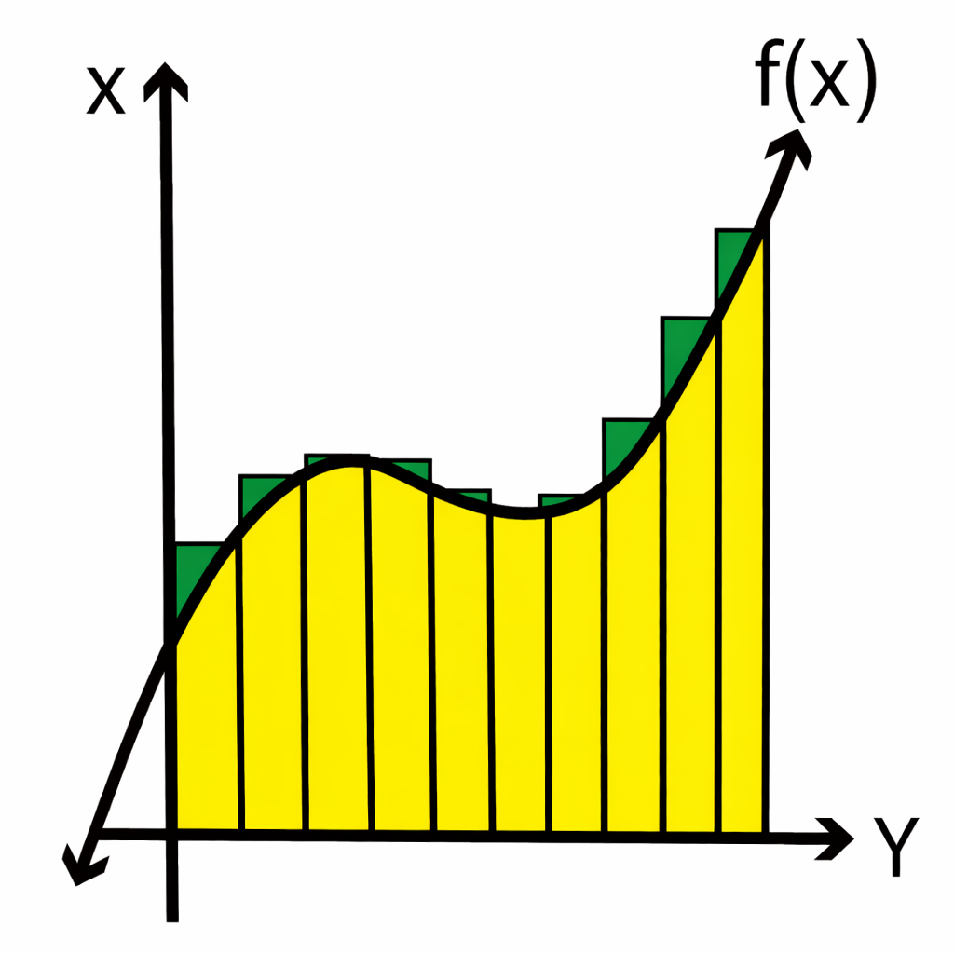
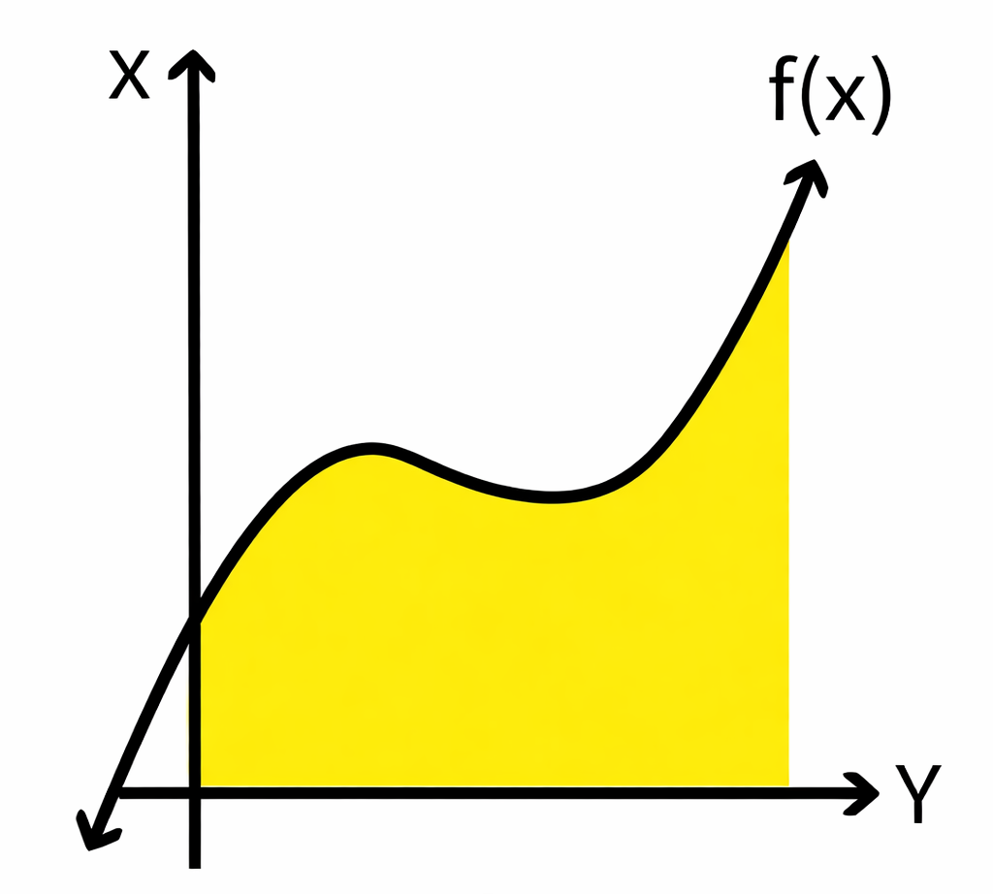
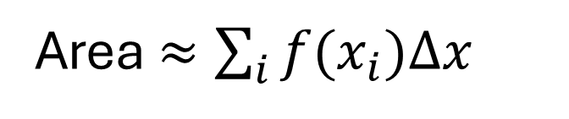

Background
  In Calculus A, we learned how to find the area under a curve
  We started with a Riemann sum
  Taking the limit $Δx→0$, we got an integral
Area = $\int_{a}^{b}{f\left(x\right)dx}$
Area $≈\sum_{i}{f(x_{i})Δx}$

Slide 3
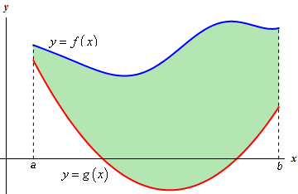
Area Between Curves
  What if we want to find the area between two curves?

Slide 4

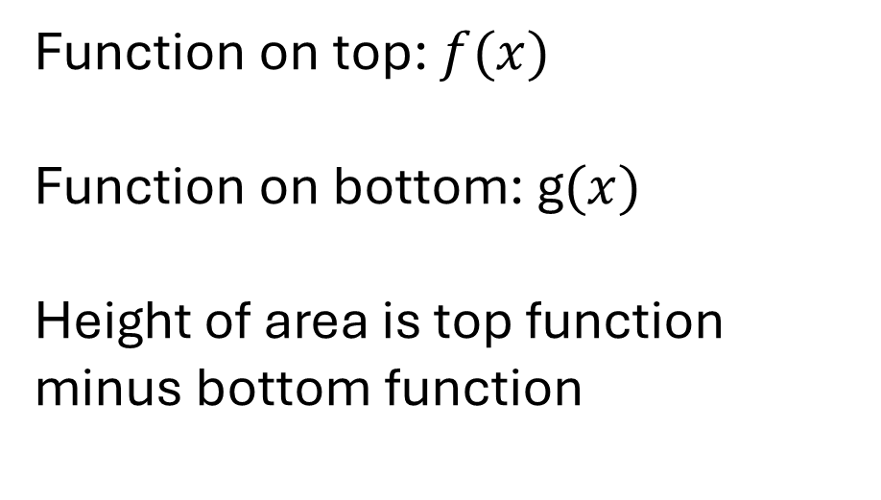
Area Between Curves
Function on top: $f(x)$
Function on bottom: g$(x)$
Height of area is top function minus bottom function
Area = $\int_{a}^{b}{(f\left(x\right)−g(x))dx}$

Slide 5
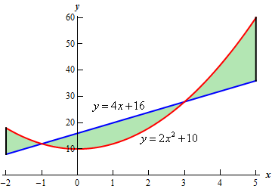
More Complicated Curves
  What do we do in this scenario?

Slide 6
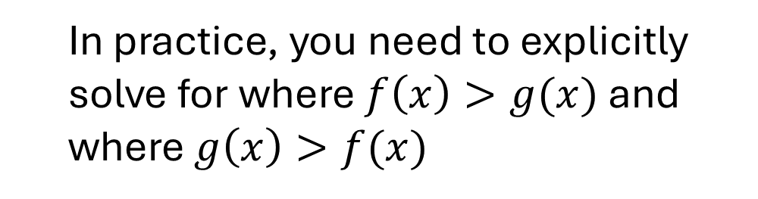

More Complicated Curves
  General Formula (for x integration):
Area = $\int_{a}^{b}{|f\left(x\right)−g\left(x\right)|dx}$
  In practice, you need to explicitly solve for where $f\left(x\right)>g(x)$ and where $g\left(x\right)>f(x)$

Slide 7
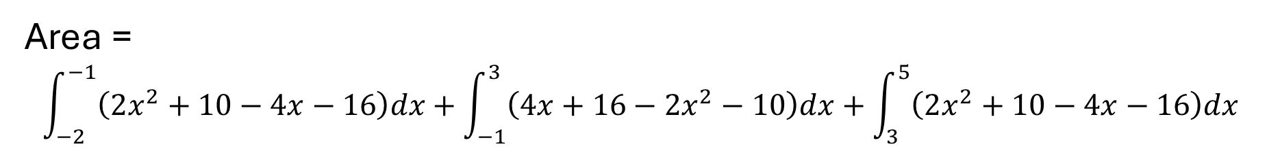


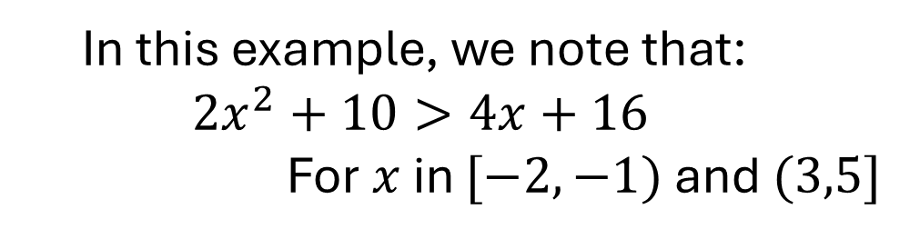
A Complicated Curve Example
  In this example, we note that:
  $$2x^{2}+10>4x+16$$
  For $x$ in $[−2,−1)$ and $(3,5]$
  $$2x^{2}+10<4x+16$$
  For $x$ in $(−1,3)$
Area = $\int_{a}^{b}{|f\left(x\right)−g\left(x\right)|dx}$
Area =
$$\int_{−2}^{−1}{\left(2x^{2}+10−4x−16\right)dx+\int_{−1}^{3}{\left(4x+16−2x^{2}−10\right)dx}+\int_{3}^{5}{\left(2x^{2}+10−4x−16\right)dx}}$$

Slide 8
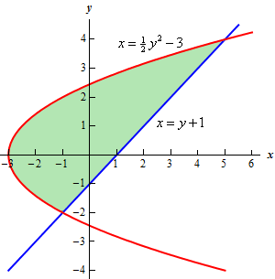

Area Between Curves
Edges as functions of $y$
  What do we do in this scenario?

Slide 9

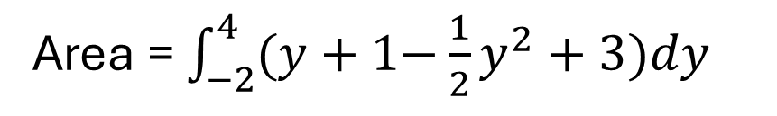
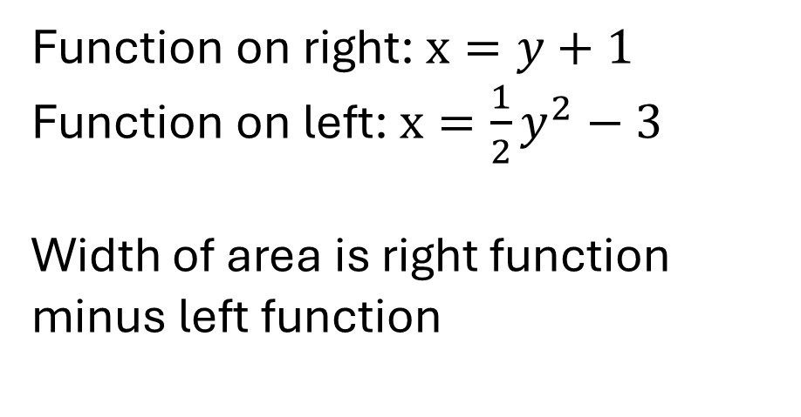
Area Between Curves
Edges as functions of $y$
  Instead of a top function and a bottom function, we now have a left function and a right function
Function on right: $x=y+1$
Function on left: $x=\frac{1}{2}y^{2}−3$
Width of area is right function minus left function
Area = $\int_{−2}^{4}{(y+1\text{−}\frac{1}{2}y^{2}+3)dy}$
**Note that the integration is over $y$!

